Slide 1
RCM Health and Safety Representatives briefing: workplace inspections Alice Sorby, Employment Relations Advisor

Slide 2
Time off to carry out your duties
If you have union-appointed health and safety representatives or representatives elected by employees in your workplace, then you have a duty to:
let them have time with pay during their normal working hours as is necessary to carry out their functions.
let them have time with pay as is necessary to be trained to perform their functions, as reasonable in the circumstances.
Partners should maintain the focus on safety and wellbeing, so staff feel supported and able to deliver care to patients.

Slide 3
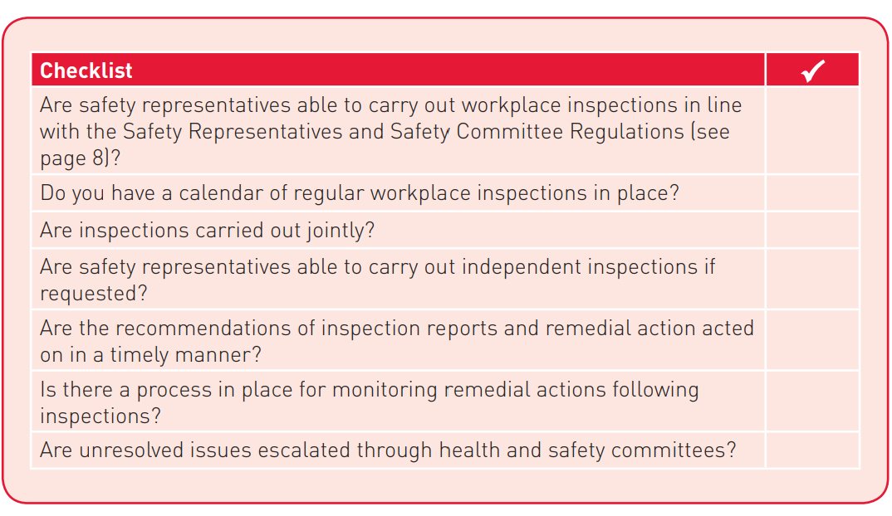
When should you carry out a workplace inspection?
the workplace has not been inspected for three months
there has been a substantial change in work conditions
there has been a notifiable accident, illness or dangerous occurrence
new information becomes available relevant to the hazards in the workplace
a member complains about health and safety in the workplace
if the safety representative believes there is a potential hazard that should be investigated.

Slide 4
Inspection checklist
Asbestos
Chemicals
Cleanliness
Electrical safety
Fire precautions
First aid, accidents, illnesses
Gas safety
Lighting
Lifting and manual handling
Machinery and equipment
Noise
Overcrowding
Protective clothing
Slips, trips and falls
Stress
Toilets, wash and rest facilities
Ventilation
Violence

